Slide 1

Conquest Grid AI
Advanced Game Agents & Evaluation Framework
Presented by:
Harika Manchineella
Karthik Kandimalla

Slide 2
Project Overview
Key Components
Objective
>
Game Engine: A custom 6x6 deterministic board game with "capture" mechanics.
To design, implement, and rigorously evaluate Artificial Intelligence agents for "Conquest Grid", a complex territory-control strategy game. The project focuses on comparing classical search methods against stochastic simulation approaches.
>
AI Suite: Implementation of Random, Minimax (Alpha-Beta), MCTS, and Q-Learning agents.
>
Evaluation: A robust tournament framework to measure win rates and decision quality.

Slide 3

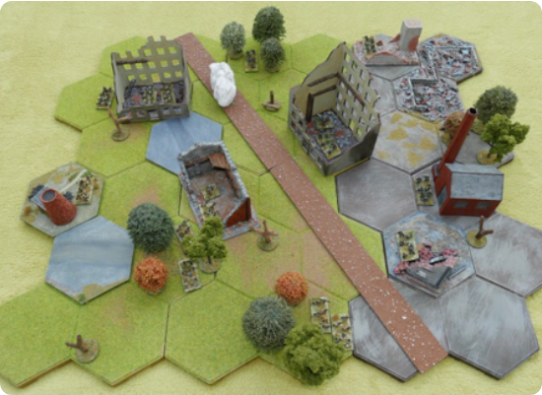
The Game: Conquest Grid
Rules of Engagement
>
Grid: Played on a 6x6 board.
>
Mechanic: Placing a piece captures all adjacent opponent pieces (horizontal, vertical, diagonal).
>
Turn-Based: Players alternate placing pieces on empty cells.
>
Victory: The player with the highest piece count when the board is full wins.

Slide 4






System Architecture
Game Engine
AI Agents
Evaluator
NumPy-based state management. Handles move validation, piece capturing logic, and win condition checks.
Modular agent interface (BaseAgent). Includes Random, Minimax, MCTS, and Q-Learning implementations.
Tournament runner and metric collector. Measures win rates, execution time, and move quality.

Slide 5
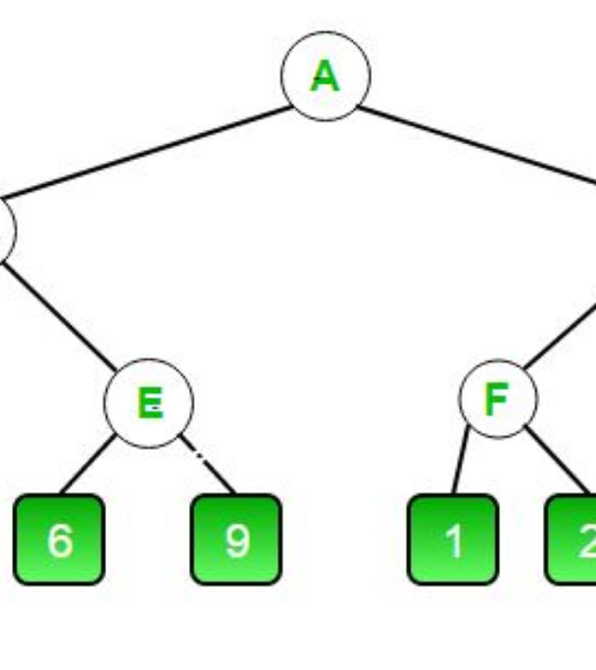
Minimax Agent
Deterministic Search
The Minimax agent explores the game tree to a fixed depth, assuming the opponent plays optimally. It guarantees the best possible move within its search horizon.
Key Features
>
Alpha-Beta Pruning: Significantly reduces the search space by eliminating branches that don't need to be evaluated.
>
Depth Limited: Configurable depth (default=3) to balance decision quality with computation time.

Slide 6






Heuristic Evaluation
Since the game tree is too large to solve completely, we evaluate leaf nodes using a weighted formula:
Territory Control
Center Control
Mobility
The difference in piece count between the agent and the opponent. Primary driver of victory.
Bonus points for occupying the 4 central squares, which offer strategic influence over the board.
The number of valid moves available. Prevents the agent from getting boxed into bad positions.

Slide 7
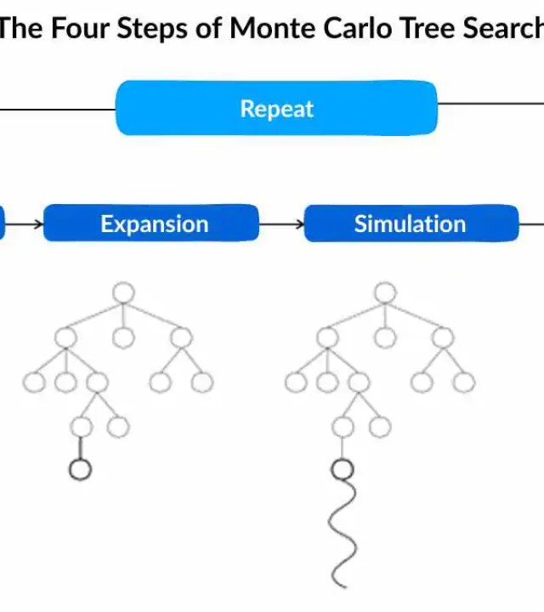
MCTS Agent
Stochastic Simulation
Monte Carlo Tree Search (MCTS) builds a search tree asymmetrically by simulating random games. It excels in complex states where static heuristics fail.
Process Loop
>
Selection: Choose promising nodes using UCB1.
>
Expansion: Add new child nodes.
>
Simulation: Play random moves until game end.
>
Backpropagation: Update win/loss stats up the tree.

Slide 8


Balancing Exploration vs. Exploitation
MCTS uses the Upper Confidence Bound 1 (UCB1) formula to decide which node to explore next. It balances visiting known high-win nodes (Exploitation) with visiting rarely visited nodes (Exploration).
>
wi: Number of wins for the node
>
ni: Number of visits for the node
>
N: Total visits of the parent node
>
C: Exploration constant (usually √2)

Slide 9
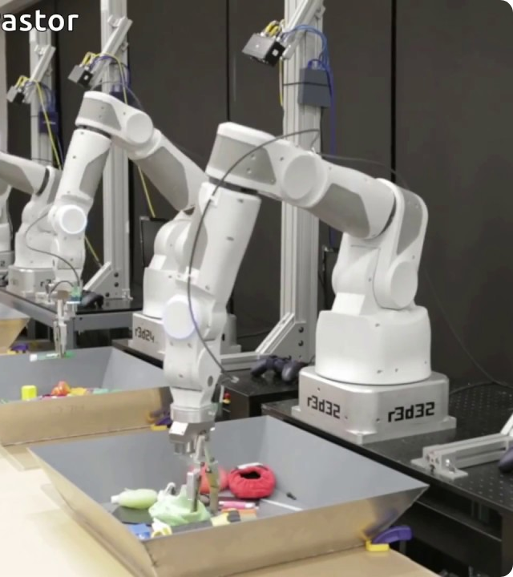
Q-Learning Agent
Learning from Experience
Unlike search algorithms, the Q-Learning agent learns a policy table mapping states to action values. It improves over time by playing thousands of games against itself or others.
Mechanics
>
Uses an ε-greedy strategy to explore random moves occasionally.
>
Updates Q-values based on rewards received at the end of the game.
>
Currently implemented as a foundation for future Deep Reinforcement Learning.

Slide 10
Evaluation Framework
Tournament Protocol
To determine the "best" agent, we conduct a round-robin tournament where every agent plays every other agent 100 times.
Key Metrics
>
Win Rate: Percentage of games won.
>
Move Time: Average computation time per turn.
Fairness Measures
>
Alternating Starts: Each pair plays 50 games as Player 1 and 50 as Player 2 to negate first-mover advantage.
>
Nodes/Sims: Complexity of the search.
>
Decision Quality: Compare moves against an Oracle (Minimax Depth 5).
>
Strict Time Limits: Agents exceeding move time limits are disqualified (though rare in this grid size).

Slide 11
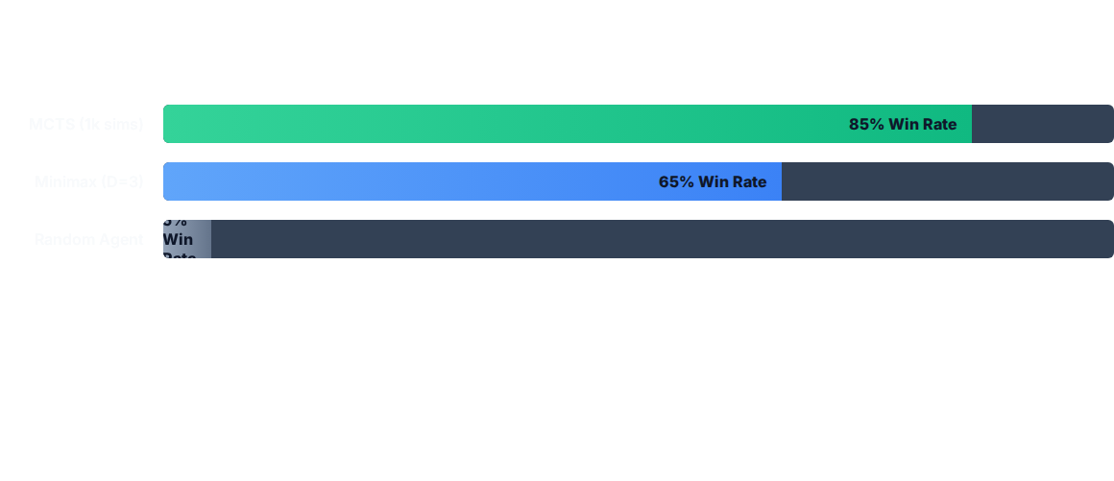
Tournament Results
MCTS consistently outperforms Minimax at Depth 3 because it can plan deeper into the game using simulations, whereas Minimax is limited by its rigid horizon.

Slide 12



Future Roadmap
Deep RL
Optimization
Web GUI
Replace the tabular Q-Learning with a Deep Q-Network (DQN) to handle larger board sizes and more complex states without a lookup table.
Rewrite the core game engine in C++ or Rust and expose bindings to Python. This would allow MCTS to run 10x more simulations in real-time.
Expand the FastAPI backend to serve a React-based frontend, allowing users to play against the AI agents in the browser.

Slide 13
Questions?
Thank you for your attention.

